Slide 1
Pythonic LADS OPC UA Client
Dr. Matthias Arnold Aachen, December 2023

Slide 2
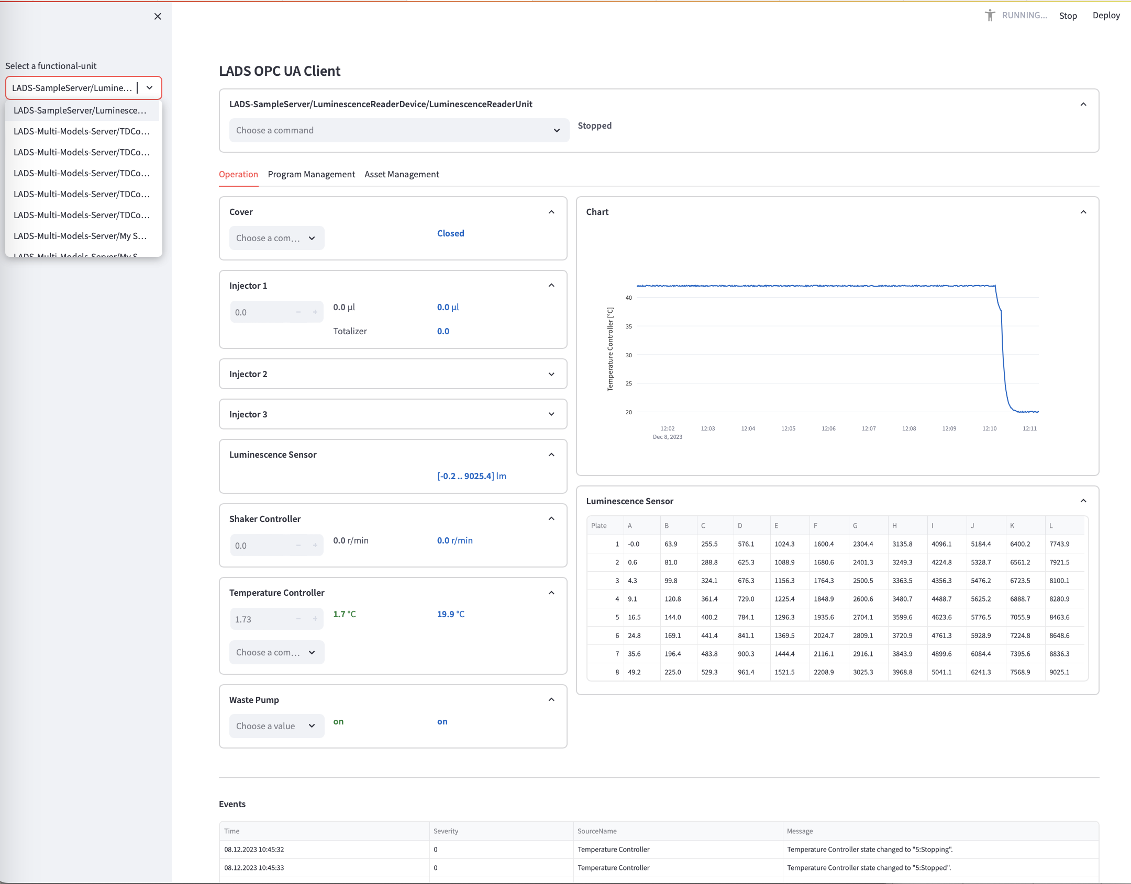
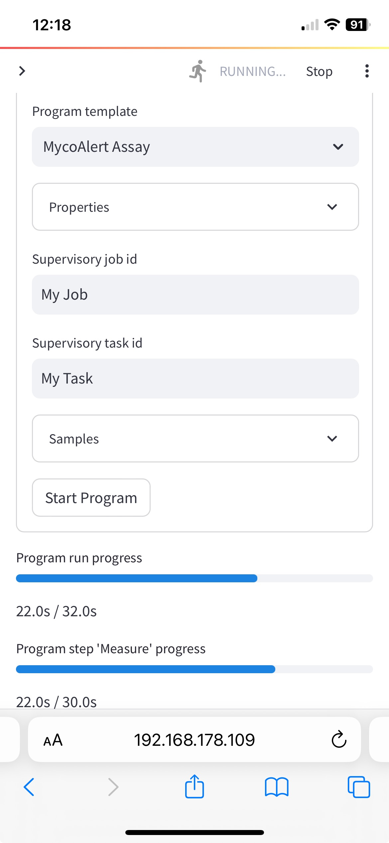
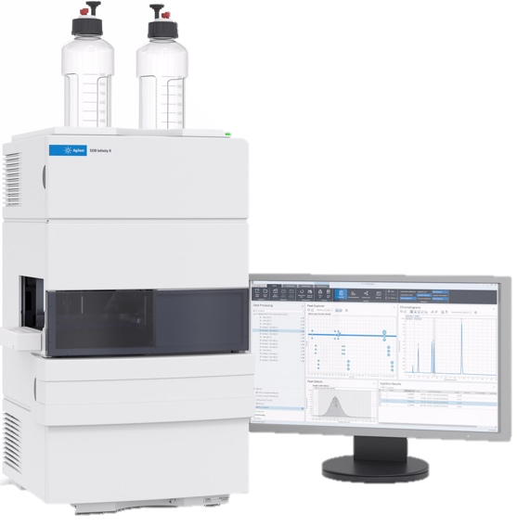
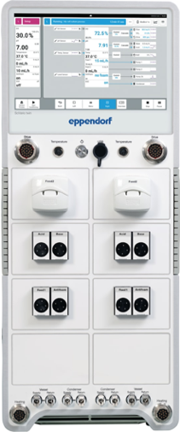
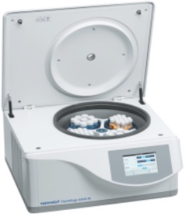
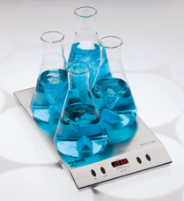
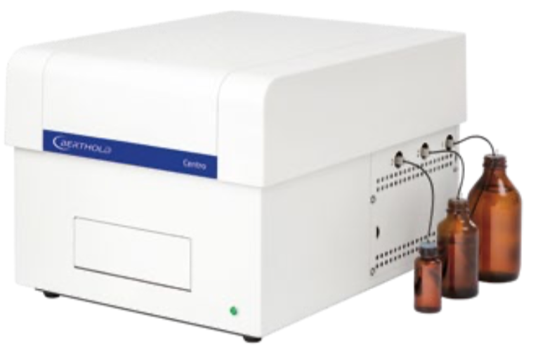
LADS OPC UA Client
lads_viewer.py (based on streamlit.io)
Images copyright by Eppendorf AG, Schmidt & Haensch, 2mag, Agilent, Hettich
lads_client.py (based on opcua-asyncio)
LADS OPC UA enabled devices
Notes:
We are all aware that such connectivity is hard to achieve in our domain.
It is hard to establish plug-and-play interoperability between the many different lab- and analytical devices on one side
and all the different applications like SCADA, LIMS, ELN, data-, asset- or service management on the other side.
We, the team behind the LADS OPC-UA Joint Work Group are trying to overcome at least some of the obstacles with an OPC-UA based communication protocol that addresses some of the most important, common use-cases in the laboratory domain.

Slide 3
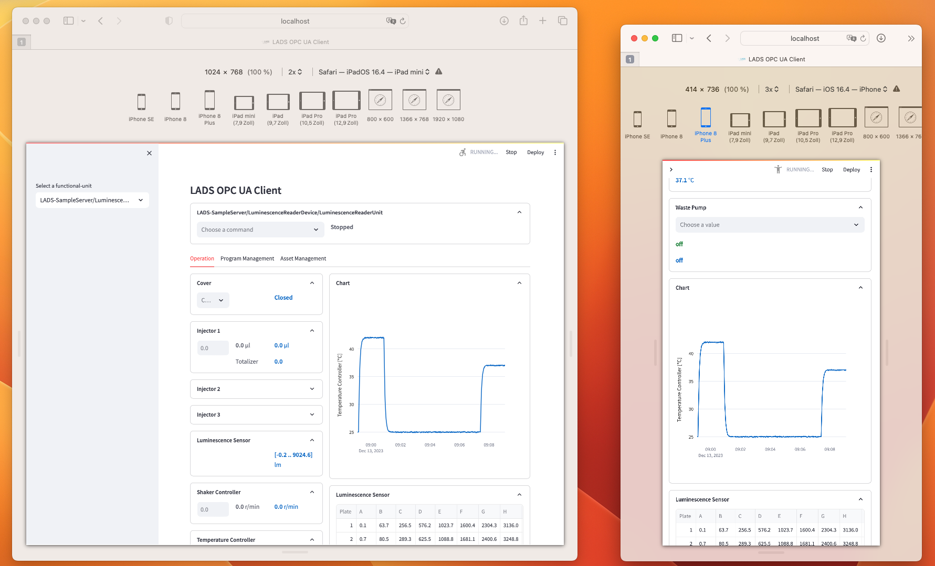
Responsive Design - Thanks to streamlit.io ..
Notes:
We are all aware that such connectivity is hard to achieve in our domain.
It is hard to establish plug-and-play interoperability between the many different lab- and analytical devices on one side
and all the different applications like SCADA, LIMS, ELN, data-, asset- or service management on the other side.
We, the team behind the LADS OPC-UA Joint Work Group are trying to overcome at least some of the obstacles with an OPC-UA based communication protocol that addresses some of the most important, common use-cases in the laboratory domain.

Slide 4
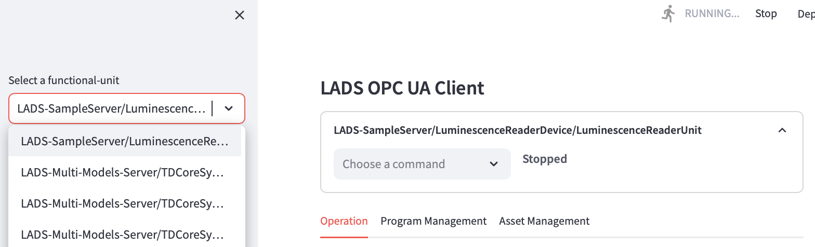
Use-Case Centric UI Design
Notes:
We are all aware that such connectivity is hard to achieve in our domain.
It is hard to establish plug-and-play interoperability between the many different lab- and analytical devices on one side
and all the different applications like SCADA, LIMS, ELN, data-, asset- or service management on the other side.
We, the team behind the LADS OPC-UA Joint Work Group are trying to overcome at least some of the obstacles with an OPC-UA based communication protocol that addresses some of the most important, common use-cases in the laboratory domain.

Slide 5






LADS Use Cases
Remote Monitoring, Alarms & Notifications
Operation / Basic Automation
Remote Control
Program Management & Orchestration
Program & Result Management Orchestration
Results Management
Condition Monitoring & Maintenance
Asset Management
Device & Fleet Management
Notes:
What are the use-cases we are targeting?
First: remote monitoring, alarms & notifications – this is the foundation because if you can’t see what is going on you can not decide or act.
Monitoring is complemented by remote control – so you can start or stop functions, change parameters or setpoints, and so on.
The remote monitoring and control use-cases are the foundation for automation.
Second: program management and orchestration; for example, listing all the program templates on the instrument, selecting a program to be executed, starting the program run, monitoring the program’s progress and so on.
For most devices, especially analyzers, result data is generated. This data usually resides on the instrument before being uploaded to an application.
The program-management and result-management use-cases form the basis for orchestrating instruments along workflows.
Third: the use cases required for asset management; such as condition monitoring, maintenance, service, calibration, validation and so on.
They are the foundation for business cases such as enhanced serviceability.
Put in a nutshell: LADS supports the use-cases automation, orchestration, service & asset management.

Slide 6
LADS System Modeling Devices, Components, Functional Units, Functions, ..
A Device is tangible and composed of tangible Components.
A Functional Unit aggregates functions to achieve a specific outcome and is typically utilized by only one user at a time.
Functions are organized by a Functional Unit and used to achieve specific outcomes (“do the job”). They might utilize one ore more tangible components.
A Program Manager organizes the objects required to manage program templates, run programs and manage their results
Device / Comp.
Functional Unit
Function
Program Manager
Low
Notes:
In the next slides I will give you a brief introduction to some of LADS’s high level information modeling patterns:
First, the hardware view, required for all the use cases around asset management including maintenance & service.
The hardware view models Devices and their Components
Devices and Components typically have properties like nameplates, date of installation, condition monitoring, status of calibration & validation and so on.
Second, the functional view which deals with data relevant for the operation, automation and orchestration of an instrument
A Functional Unit aggregates functions to achieve a specific outcome and is typically utilized by only one user at a time.
Within functional units you will find smaller functions which do the job, like sensor measurements, closed loop controllers and so on.
Many laboratory and analytical devices allow the user to define and run programs, also called methods. The Program Manager organizes such program templates, runs programs and finally manages the result data generated during a run. In other words: the program manager provides device-level orchestration.

Slide 7
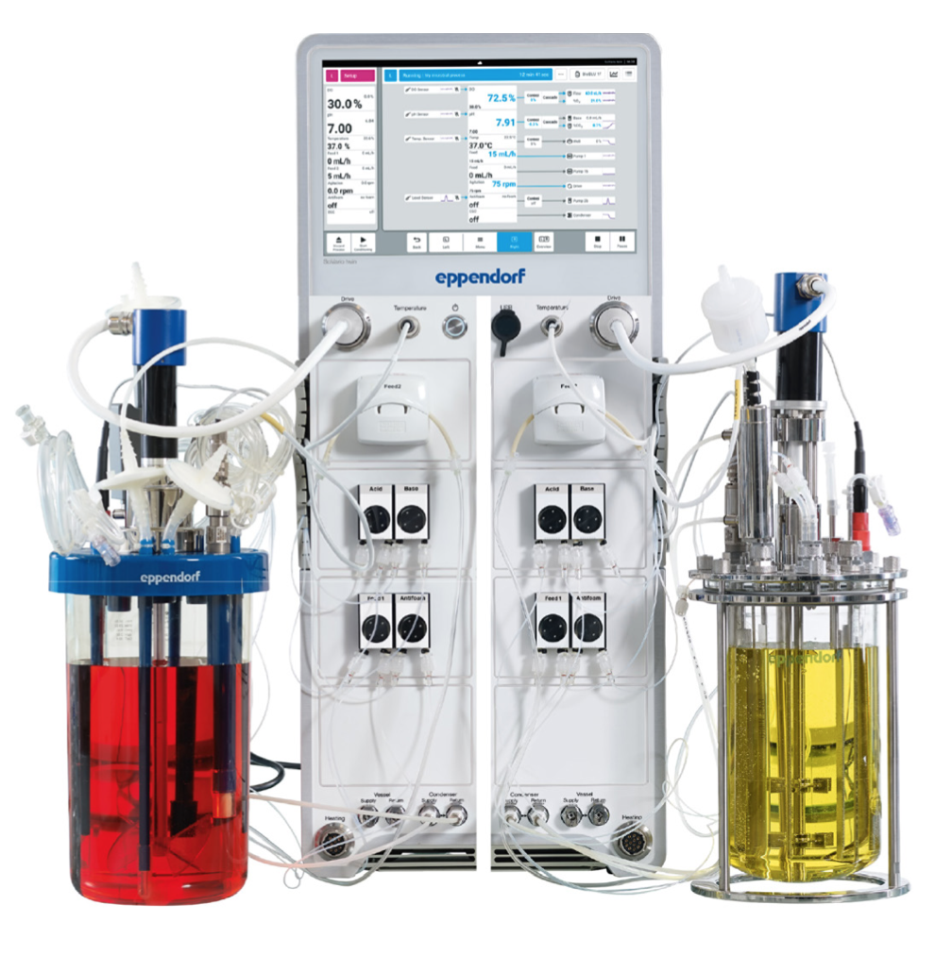
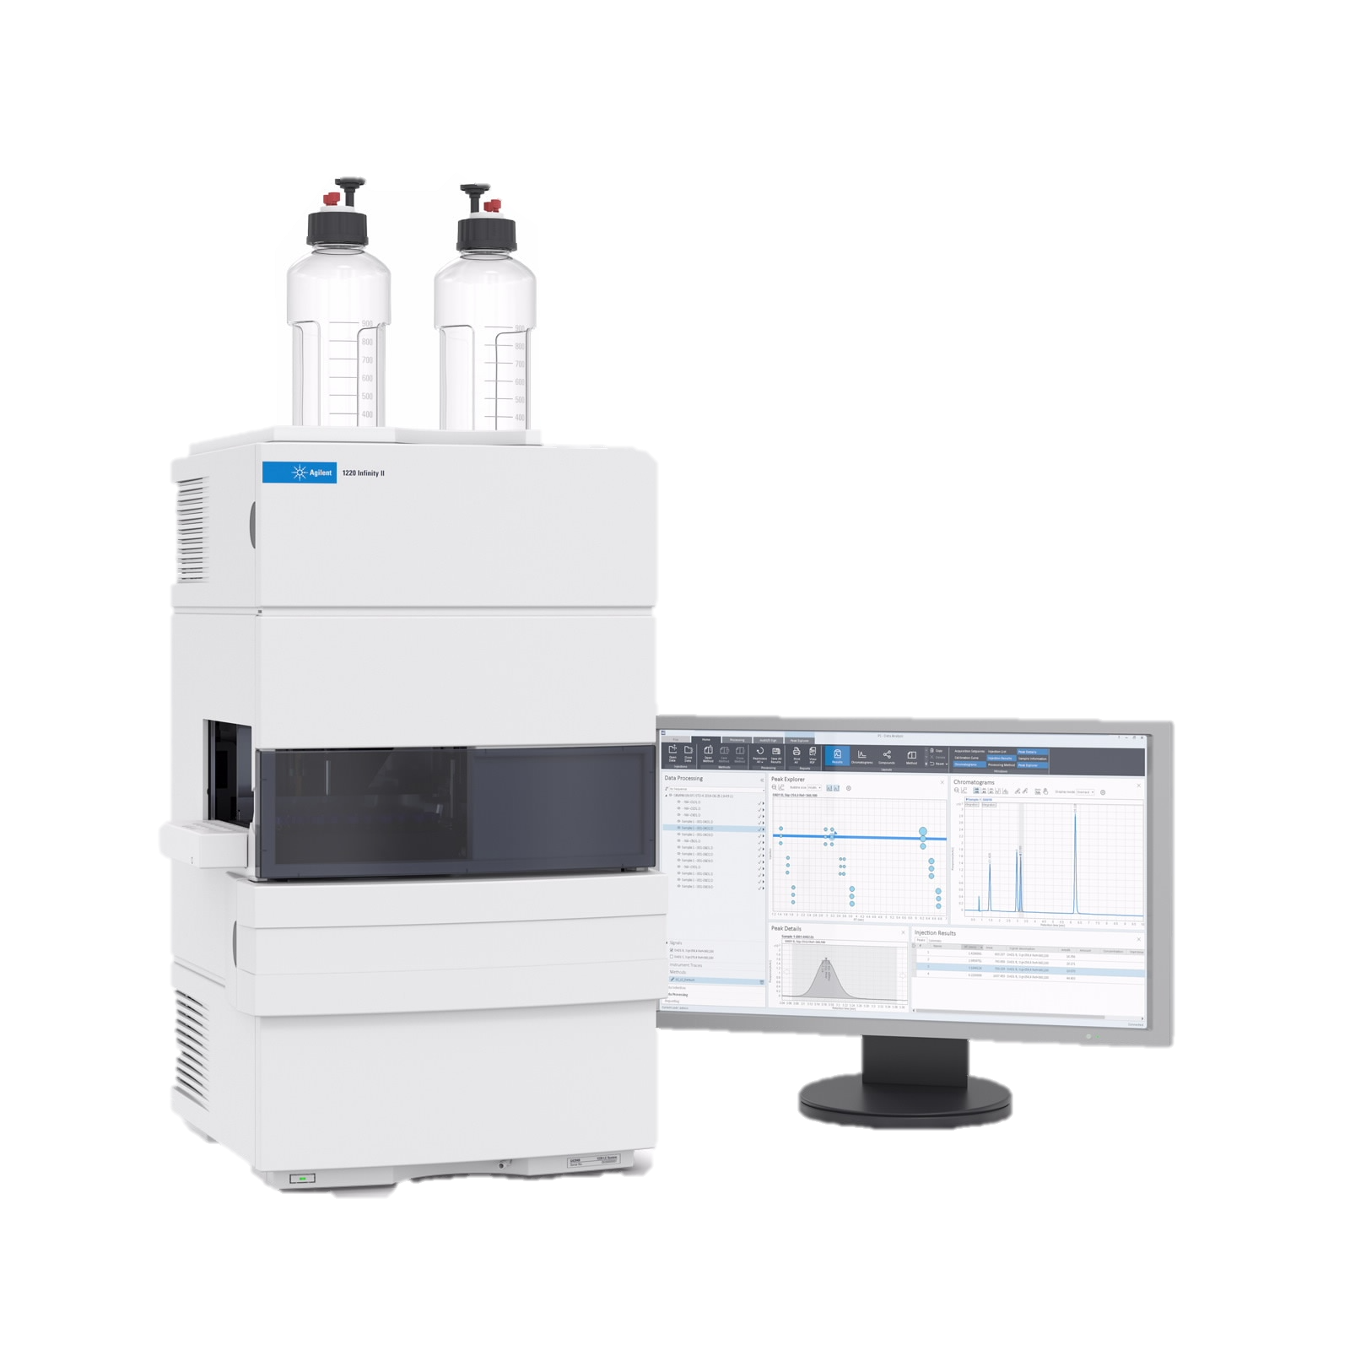
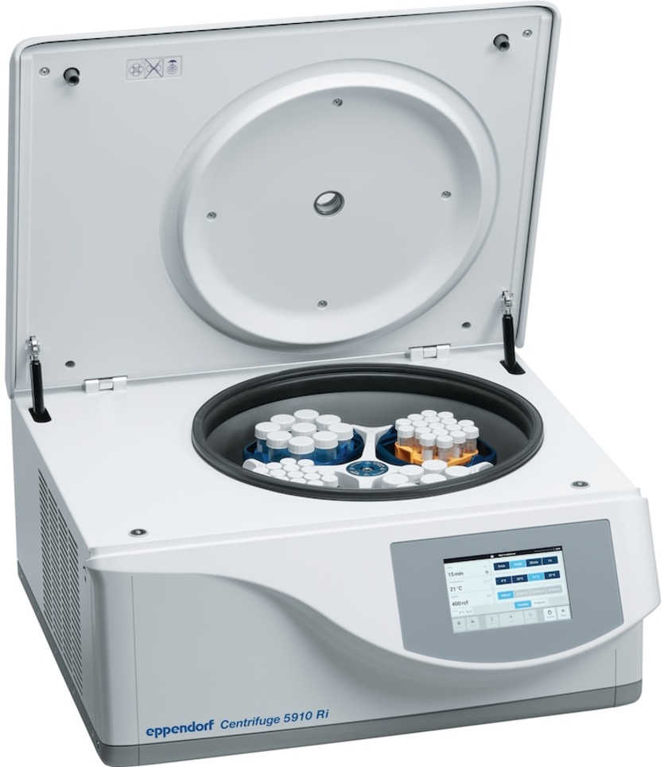
LADS System Modeling ..
Images Copyright, Eppendorf SE, Agilent
Low
Notes:
In the next slides I will give you a brief introduction to some of LADS’s high level information modeling patterns:
First, the hardware view, required for all the use cases around asset management including maintenance & service.
The hardware view models Devices and their Components
Devices and Components typically have properties like nameplates, date of installation, condition monitoring, status of calibration & validation and so on.
Second, the functional view which deals with data relevant for the operation, automation and orchestration of an instrument
A Functional Unit aggregates functions to achieve a specific outcome and is typically utilized by only one user at a time.
Within functional units you will find smaller functions which do the job, like sensor measurements, closed loop controllers and so on.
Many laboratory and analytical devices allow the user to define and run programs, also called methods. The Program Manager organizes such program templates, runs programs and finally manages the result data generated during a run. In other words: the program manager provides device-level orchestration.

Slide 8
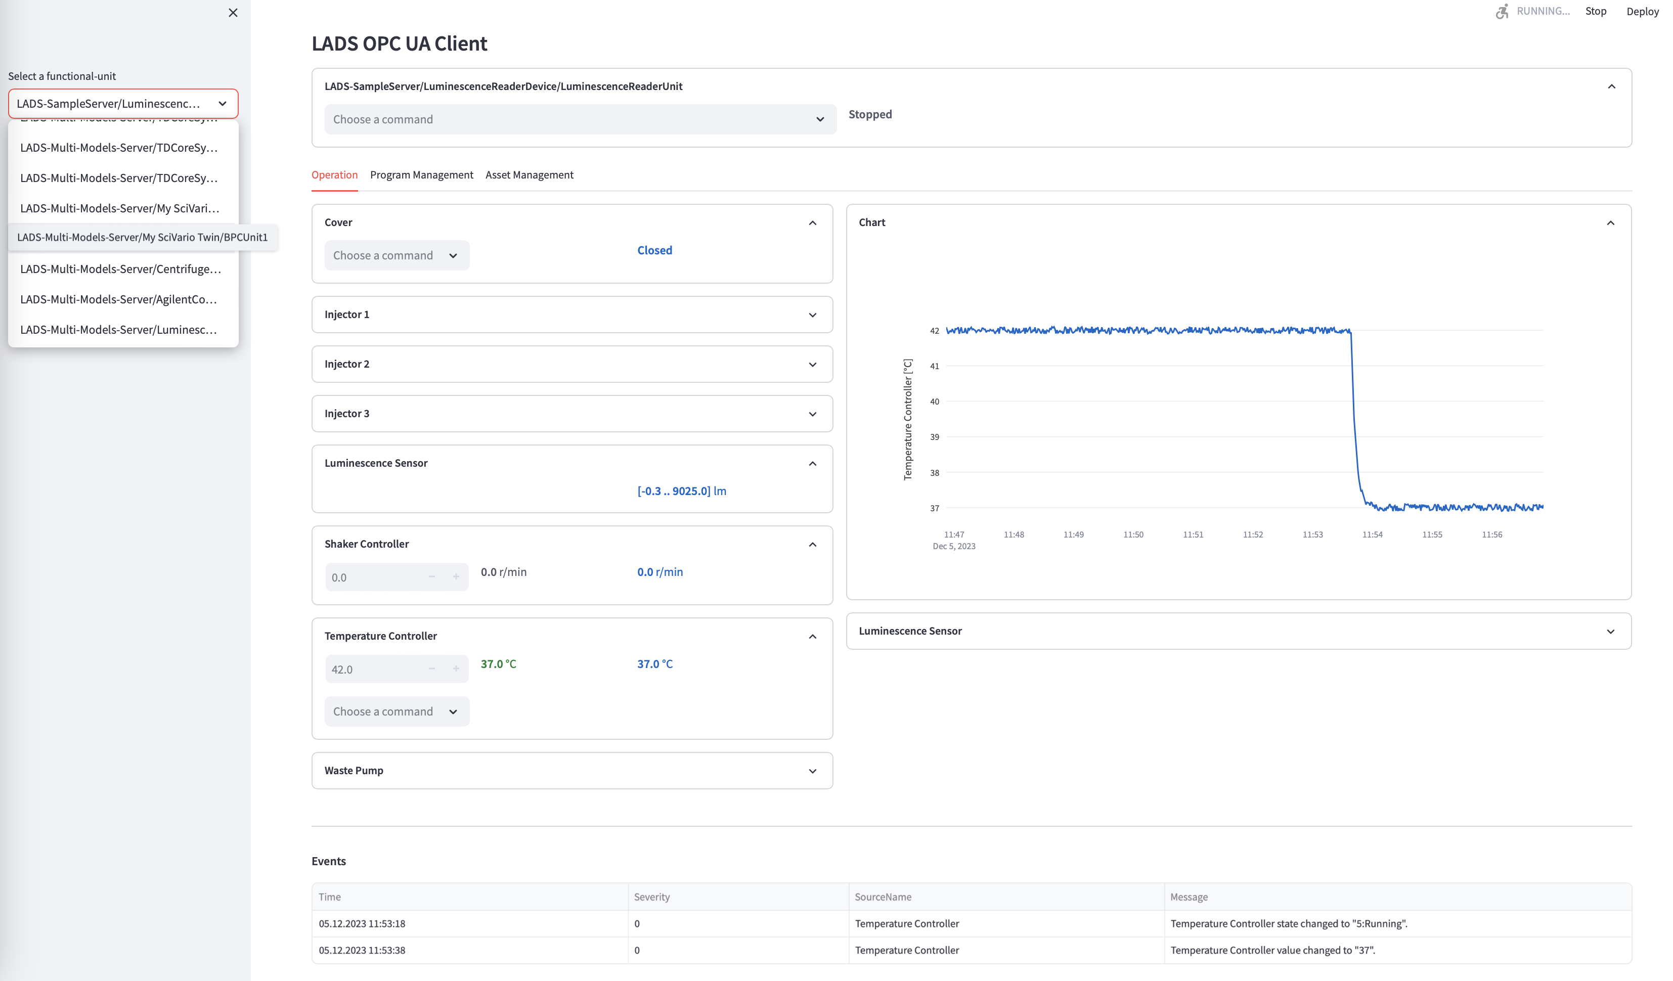
Functional unit selector
Functional unit control
Use Case
Specific Tabs (Operation selected)
Event List
(Device)
Notes:
We are all aware that such connectivity is hard to achieve in our domain.
It is hard to establish plug-and-play interoperability between the many different lab- and analytical devices on one side
and all the different applications like SCADA, LIMS, ELN, data-, asset- or service management on the other side.
We, the team behind the LADS OPC-UA Joint Work Group are trying to overcome at least some of the obstacles with an OPC-UA based communication protocol that addresses some of the most important, common use-cases in the laboratory domain.

Slide 9
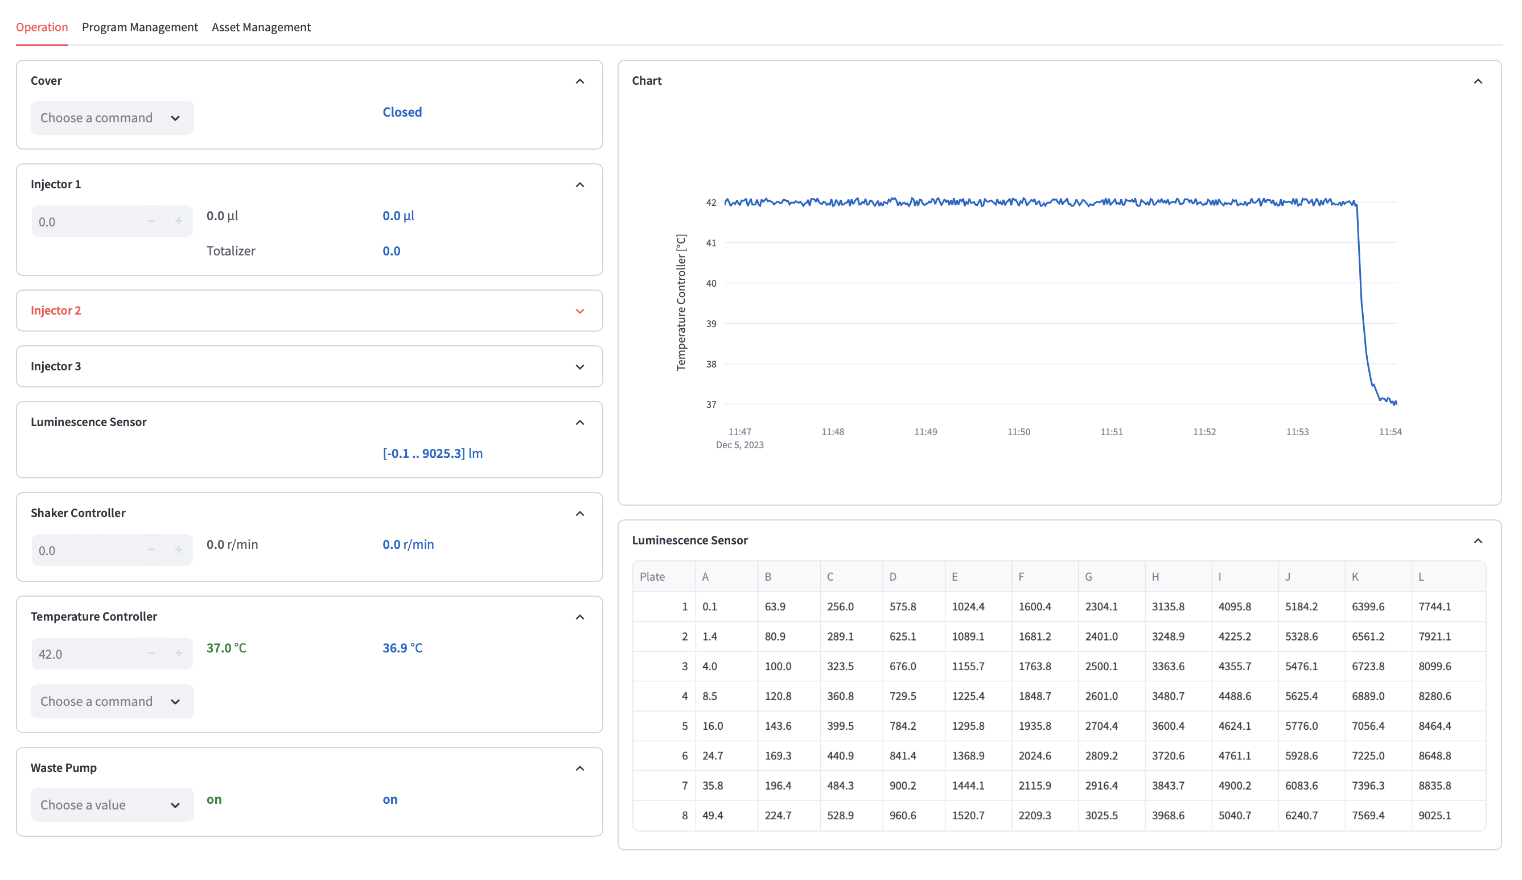
Use-Case: Operation / Basic Automation
Function list
Chart view (historizing variables)
Array sensor view
Notes:
We are all aware that such connectivity is hard to achieve in our domain.
It is hard to establish plug-and-play interoperability between the many different lab- and analytical devices on one side
and all the different applications like SCADA, LIMS, ELN, data-, asset- or service management on the other side.
We, the team behind the LADS OPC-UA Joint Work Group are trying to overcome at least some of the obstacles with an OPC-UA based communication protocol that addresses some of the most important, common use-cases in the laboratory domain.

Slide 10
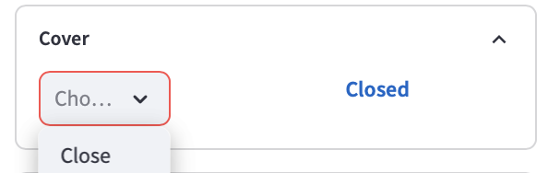
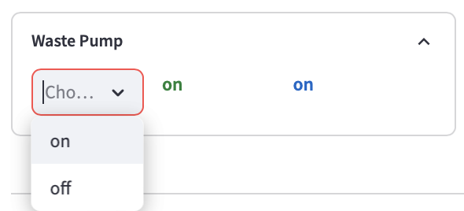
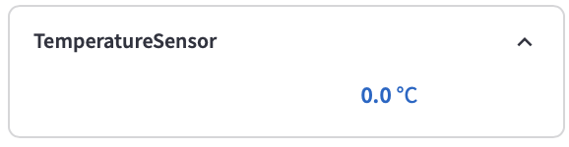
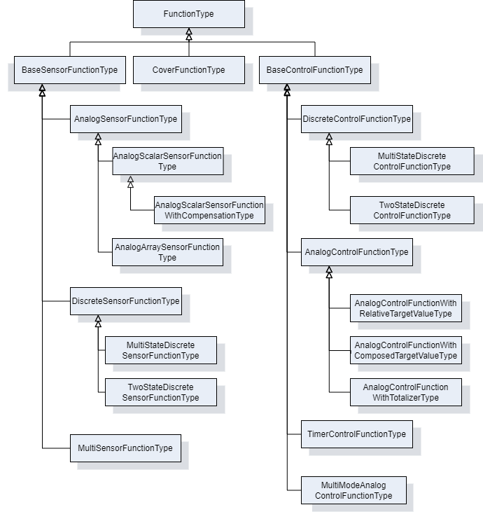
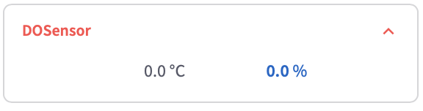
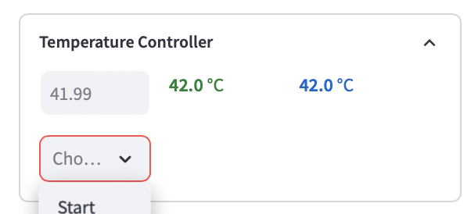
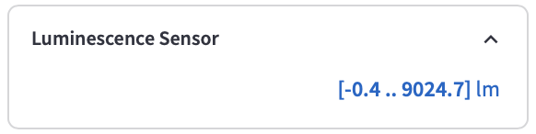
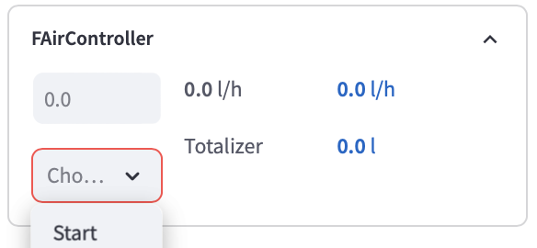
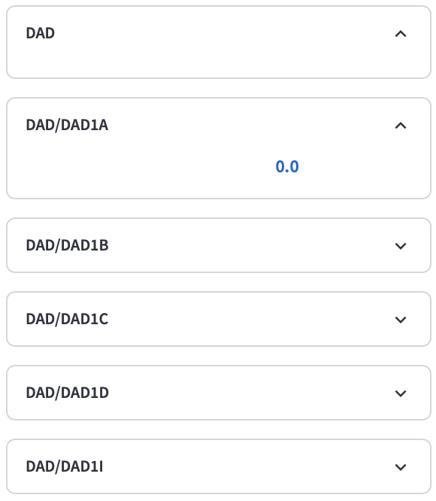
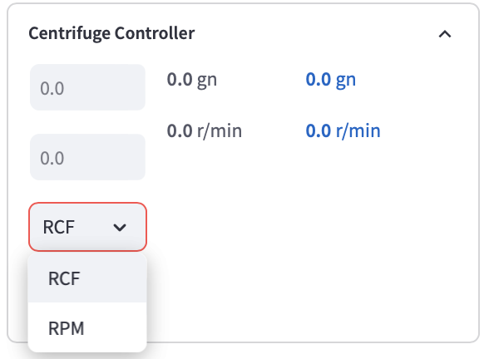

















Use-Case: Operation - LADS Functions
✔️$︎$
✔️$︎$
✔️$︎$
✔️$︎$
✔️$︎$
✔️$︎$
✔️$︎$
✔️$︎$
✔️$︎$
✔️$︎$
✔️$︎$
✔️$︎$
✔️$︎$
✔️$︎$
✔️$︎$
✔️$︎$
✔️$︎$
✔️$︎$
Notes:
We are all aware that such connectivity is hard to achieve in our domain.
It is hard to establish plug-and-play interoperability between the many different lab- and analytical devices on one side
and all the different applications like SCADA, LIMS, ELN, data-, asset- or service management on the other side.
We, the team behind the LADS OPC-UA Joint Work Group are trying to overcome at least some of the obstacles with an OPC-UA based communication protocol that addresses some of the most important, common use-cases in the laboratory domain.

Slide 11
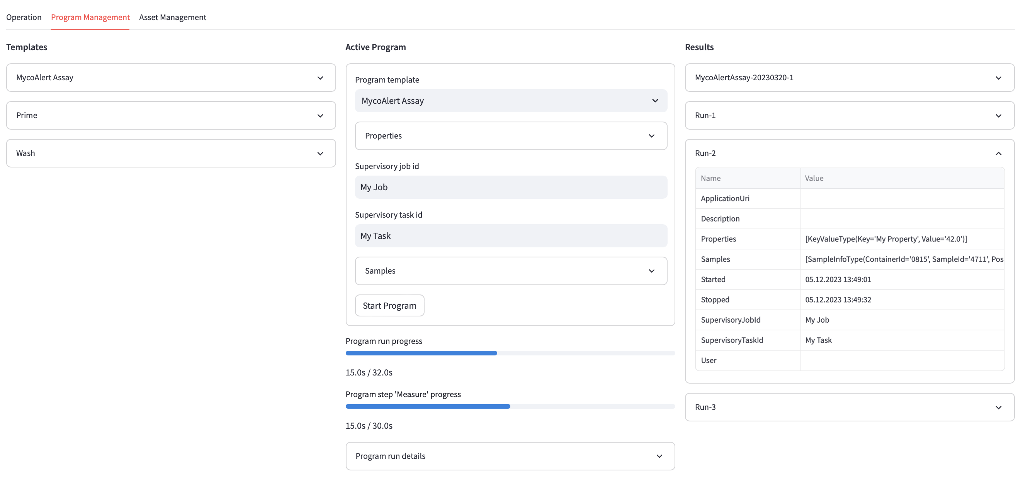
Use-Case: Program & Result Management / Orchestration
Notes:
We are all aware that such connectivity is hard to achieve in our domain.
It is hard to establish plug-and-play interoperability between the many different lab- and analytical devices on one side
and all the different applications like SCADA, LIMS, ELN, data-, asset- or service management on the other side.
We, the team behind the LADS OPC-UA Joint Work Group are trying to overcome at least some of the obstacles with an OPC-UA based communication protocol that addresses some of the most important, common use-cases in the laboratory domain.

Slide 12
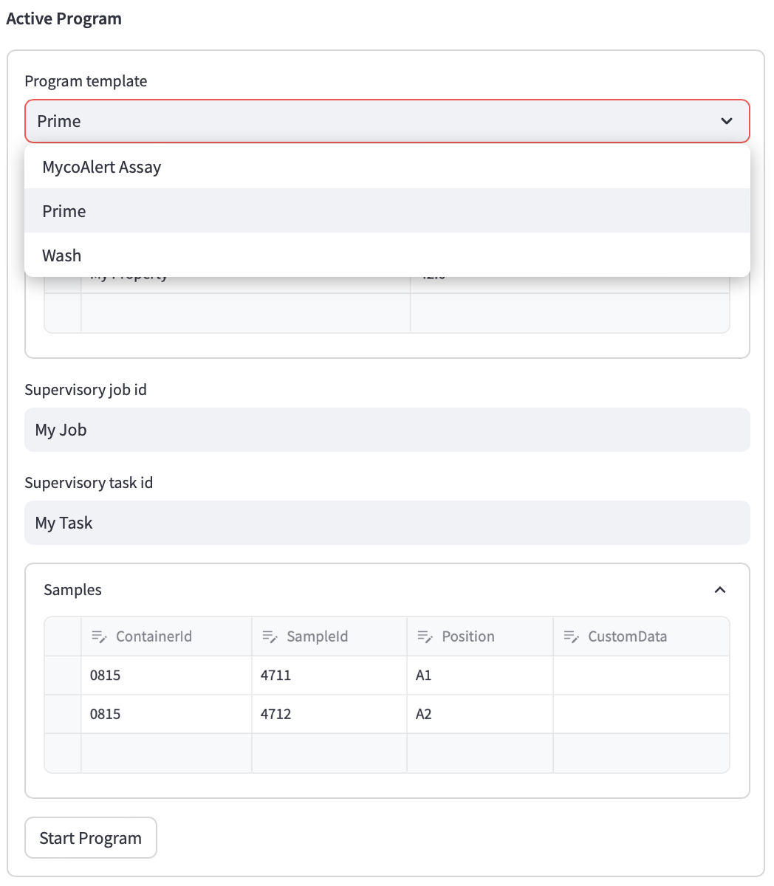
Use-Case: Program & Result Management (StartProgram())
Program template selector
Additional properties
Context information
Sample information
Start!
Notes:
We are all aware that such connectivity is hard to achieve in our domain.
It is hard to establish plug-and-play interoperability between the many different lab- and analytical devices on one side
and all the different applications like SCADA, LIMS, ELN, data-, asset- or service management on the other side.
We, the team behind the LADS OPC-UA Joint Work Group are trying to overcome at least some of the obstacles with an OPC-UA based communication protocol that addresses some of the most important, common use-cases in the laboratory domain.

Slide 13
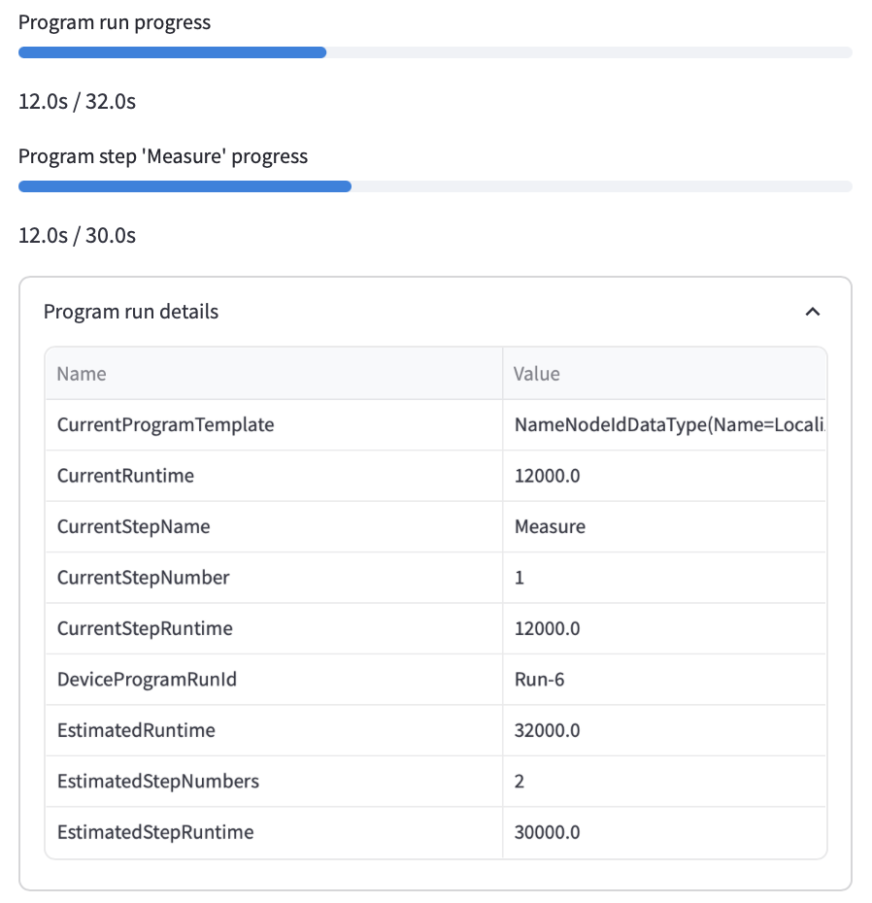
Use-Case: Program & Result Management (Execution Progress)
Progress indicators (computed based on ..)
Detail information (typically hidden)
Notes:
We are all aware that such connectivity is hard to achieve in our domain.
It is hard to establish plug-and-play interoperability between the many different lab- and analytical devices on one side
and all the different applications like SCADA, LIMS, ELN, data-, asset- or service management on the other side.
We, the team behind the LADS OPC-UA Joint Work Group are trying to overcome at least some of the obstacles with an OPC-UA based communication protocol that addresses some of the most important, common use-cases in the laboratory domain.

Slide 14
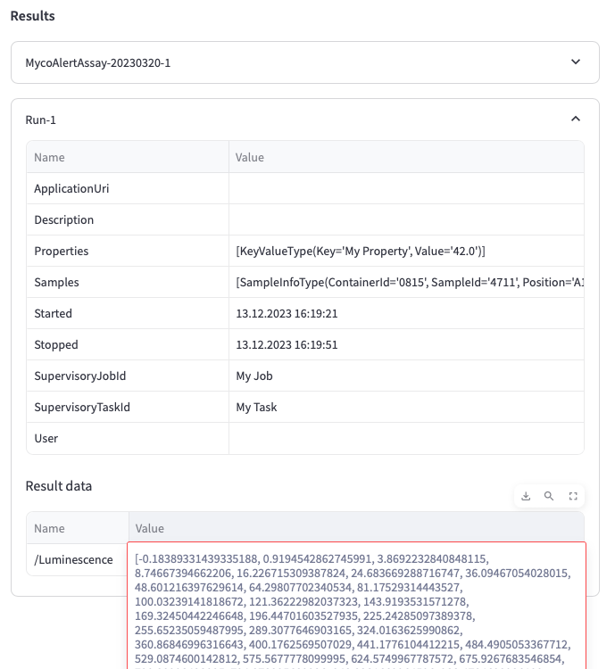
Use-Case: Program & Result Management (Results)
Program run specific context & meta-data → traceability
Program run specific result data (application specific)
Notes:
We are all aware that such connectivity is hard to achieve in our domain.
It is hard to establish plug-and-play interoperability between the many different lab- and analytical devices on one side
and all the different applications like SCADA, LIMS, ELN, data-, asset- or service management on the other side.
We, the team behind the LADS OPC-UA Joint Work Group are trying to overcome at least some of the obstacles with an OPC-UA based communication protocol that addresses some of the most important, common use-cases in the laboratory domain.

Slide 15
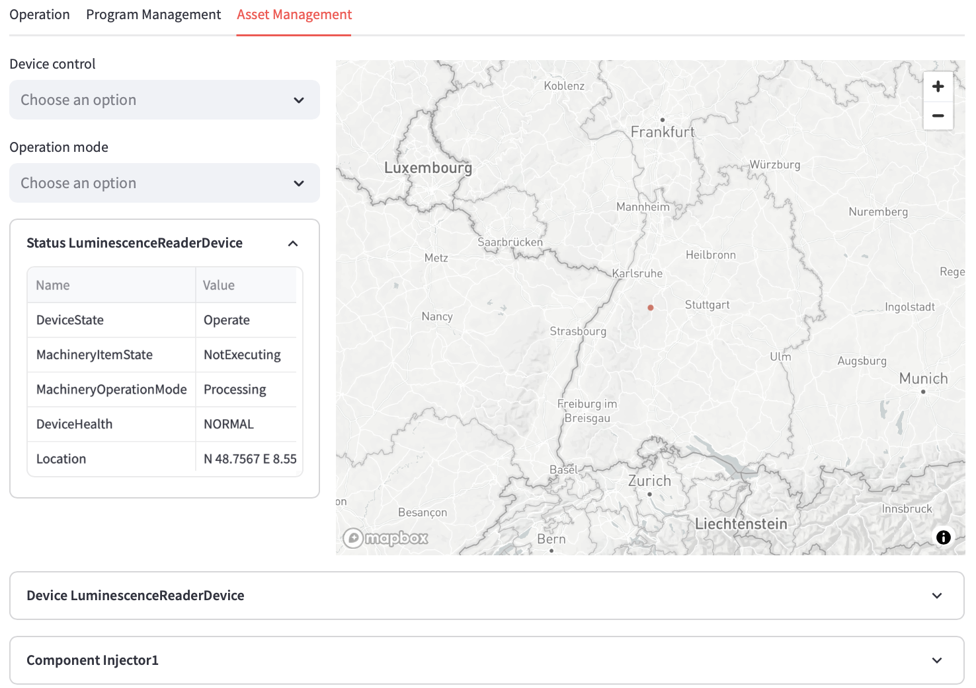
Use-Case: Asset Management (Overview)
Device control
Device location
Device state & mode (DI, Machinery)
Device components (Condition Monitoring)
Notes:
We are all aware that such connectivity is hard to achieve in our domain.
It is hard to establish plug-and-play interoperability between the many different lab- and analytical devices on one side
and all the different applications like SCADA, LIMS, ELN, data-, asset- or service management on the other side.
We, the team behind the LADS OPC-UA Joint Work Group are trying to overcome at least some of the obstacles with an OPC-UA based communication protocol that addresses some of the most important, common use-cases in the laboratory domain.

Slide 16
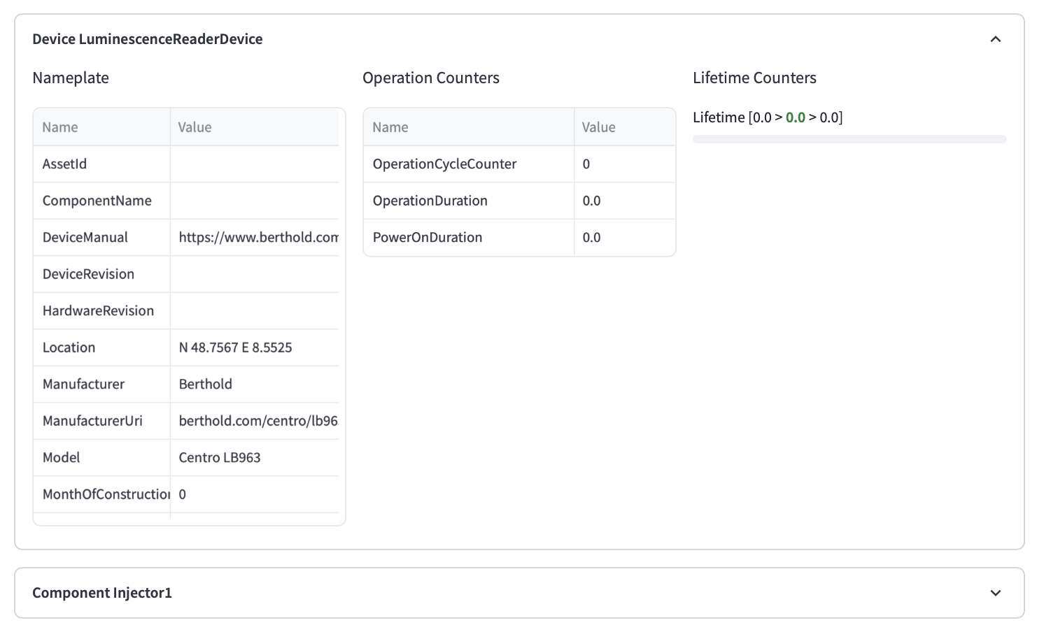
Use-Case: Asset Management (Nameplate)
Nameplate (DI, Machinery)
Notes:
We are all aware that such connectivity is hard to achieve in our domain.
It is hard to establish plug-and-play interoperability between the many different lab- and analytical devices on one side
and all the different applications like SCADA, LIMS, ELN, data-, asset- or service management on the other side.
We, the team behind the LADS OPC-UA Joint Work Group are trying to overcome at least some of the obstacles with an OPC-UA based communication protocol that addresses some of the most important, common use-cases in the laboratory domain.

Slide 17
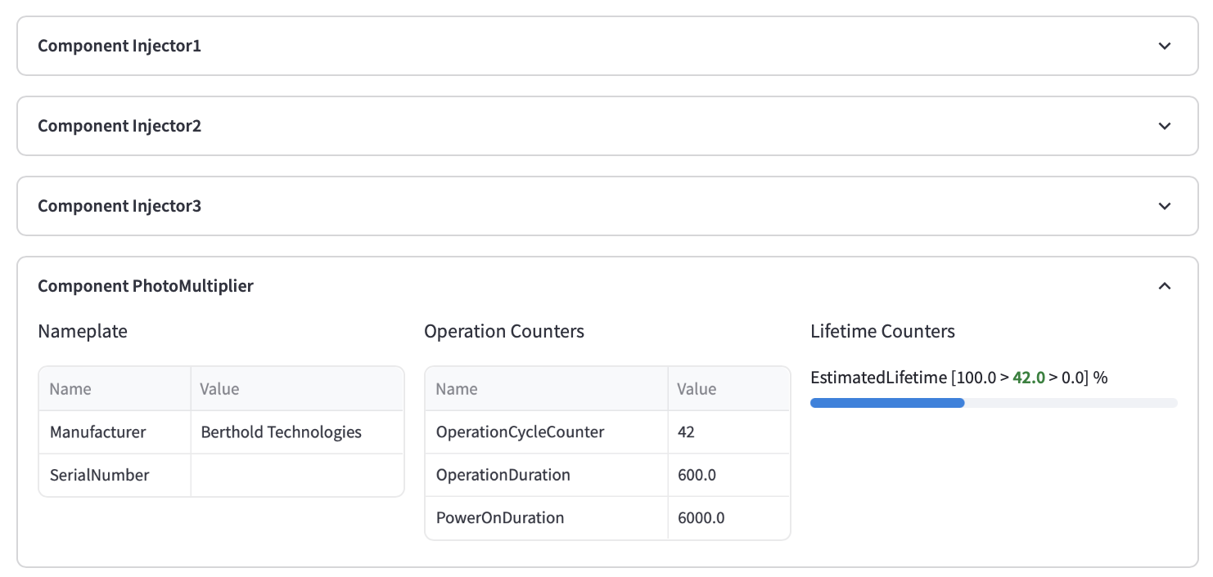
Use-Case: Asset Management (Condition Monitoring)
Lifetime Counters (DI, AMB)
Operation counters (DI)
Notes:
We are all aware that such connectivity is hard to achieve in our domain.
It is hard to establish plug-and-play interoperability between the many different lab- and analytical devices on one side
and all the different applications like SCADA, LIMS, ELN, data-, asset- or service management on the other side.
We, the team behind the LADS OPC-UA Joint Work Group are trying to overcome at least some of the obstacles with an OPC-UA based communication protocol that addresses some of the most important, common use-cases in the laboratory domain.

Slide 18
Pythonic LADS OPC UA Client Call for LADShack community support!
I intend to make the LADS OPC UA Client accessible under MIT license via GitHub.
Since I’m not an expert in Python I need your active support for
Refactoring
Quality Improvements
Packaging / bundling
..
Once the project is in an acceptable “shape” it will be available for all!
→ Reach out to me M.Arnold@AixEngineers.de
Low
Notes:
In the next slides I will give you a brief introduction to some of LADS’s high level information modeling patterns:
First, the hardware view, required for all the use cases around asset management including maintenance & service.
The hardware view models Devices and their Components
Devices and Components typically have properties like nameplates, date of installation, condition monitoring, status of calibration & validation and so on.
Second, the functional view which deals with data relevant for the operation, automation and orchestration of an instrument
A Functional Unit aggregates functions to achieve a specific outcome and is typically utilized by only one user at a time.
Within functional units you will find smaller functions which do the job, like sensor measurements, closed loop controllers and so on.
Many laboratory and analytical devices allow the user to define and run programs, also called methods. The Program Manager organizes such program templates, runs programs and finally manages the result data generated during a run. In other words: the program manager provides device-level orchestration.

Slide 19
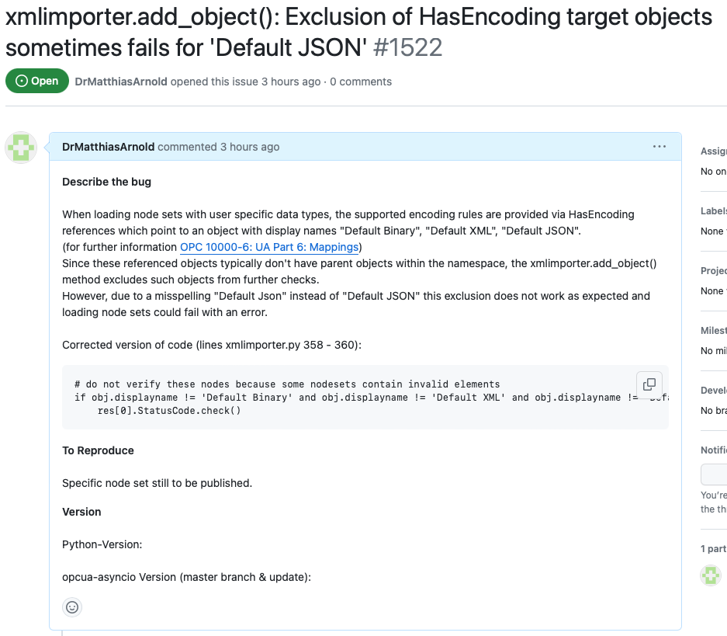
Pythonic LADS OPC UA Client Known Issues opcua-asyncio
Variables with extension-object based variables not updates in subscriptions
Event subscriptions loose events which are transferred as list on one message
load_data-types() has design issues: can only be called once and has global context instead of client-based context
..
Issues still to be reported ..
Low
Notes:
In the next slides I will give you a brief introduction to some of LADS’s high level information modeling patterns:
First, the hardware view, required for all the use cases around asset management including maintenance & service.
The hardware view models Devices and their Components
Devices and Components typically have properties like nameplates, date of installation, condition monitoring, status of calibration & validation and so on.
Second, the functional view which deals with data relevant for the operation, automation and orchestration of an instrument
A Functional Unit aggregates functions to achieve a specific outcome and is typically utilized by only one user at a time.
Within functional units you will find smaller functions which do the job, like sensor measurements, closed loop controllers and so on.
Many laboratory and analytical devices allow the user to define and run programs, also called methods. The Program Manager organizes such program templates, runs programs and finally manages the result data generated during a run. In other words: the program manager provides device-level orchestration.

Slide 20
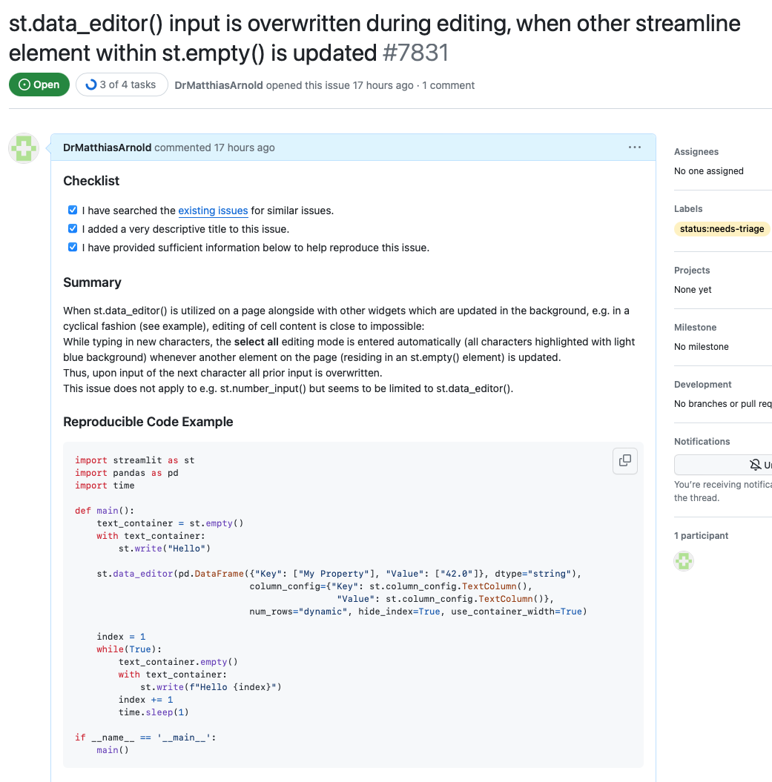
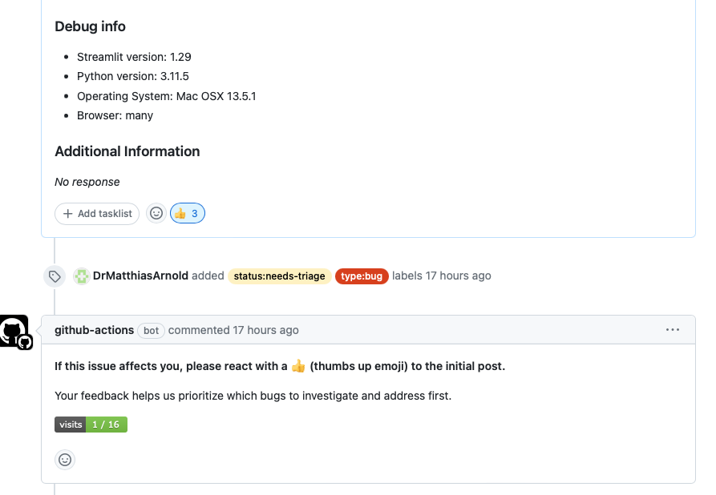
Pythonic LADS OPC UA Client Known Issues streamlit.io
Unable to edit data in st.dataeditor() since “select-all is” activated (during typing) whenever some content of the web page is updated. Important: since the issue #7831 is in status “triage” please upvote it!
st.map() is not automatically updated (see #7294 & #7307)
..
Low
Notes:
In the next slides I will give you a brief introduction to some of LADS’s high level information modeling patterns:
First, the hardware view, required for all the use cases around asset management including maintenance & service.
The hardware view models Devices and their Components
Devices and Components typically have properties like nameplates, date of installation, condition monitoring, status of calibration & validation and so on.
Second, the functional view which deals with data relevant for the operation, automation and orchestration of an instrument
A Functional Unit aggregates functions to achieve a specific outcome and is typically utilized by only one user at a time.
Within functional units you will find smaller functions which do the job, like sensor measurements, closed loop controllers and so on.
Many laboratory and analytical devices allow the user to define and run programs, also called methods. The Program Manager organizes such program templates, runs programs and finally manages the result data generated during a run. In other words: the program manager provides device-level orchestration.

Slide 21
Pythonic LADS OPC UA Client Known Issues lads_client / lads_viewer
TBD
..
Low
Notes:
In the next slides I will give you a brief introduction to some of LADS’s high level information modeling patterns:
First, the hardware view, required for all the use cases around asset management including maintenance & service.
The hardware view models Devices and their Components
Devices and Components typically have properties like nameplates, date of installation, condition monitoring, status of calibration & validation and so on.
Second, the functional view which deals with data relevant for the operation, automation and orchestration of an instrument
A Functional Unit aggregates functions to achieve a specific outcome and is typically utilized by only one user at a time.
Within functional units you will find smaller functions which do the job, like sensor measurements, closed loop controllers and so on.
Many laboratory and analytical devices allow the user to define and run programs, also called methods. The Program Manager organizes such program templates, runs programs and finally manages the result data generated during a run. In other words: the program manager provides device-level orchestration.

Slide 22
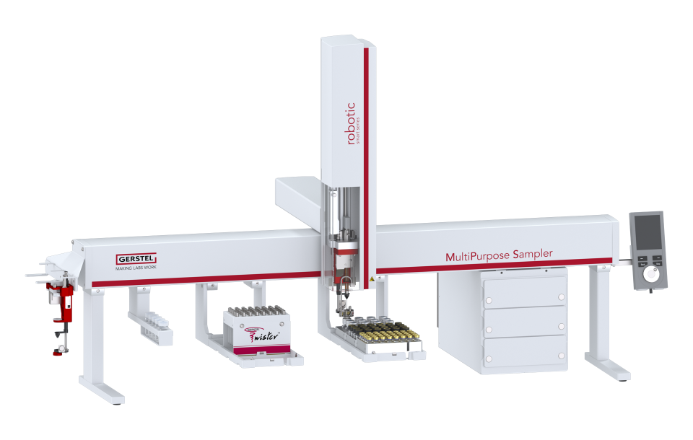
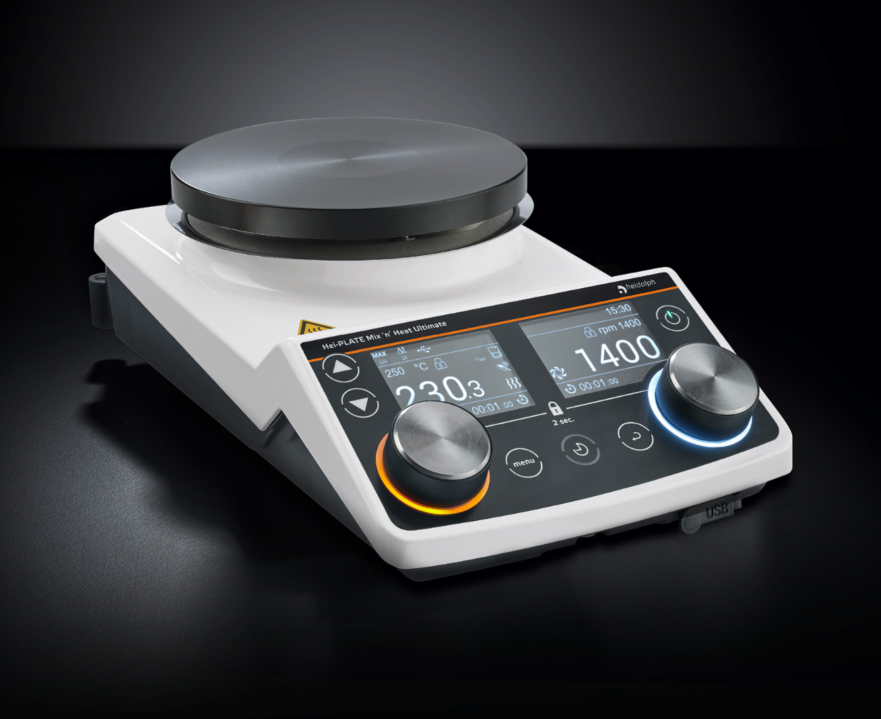
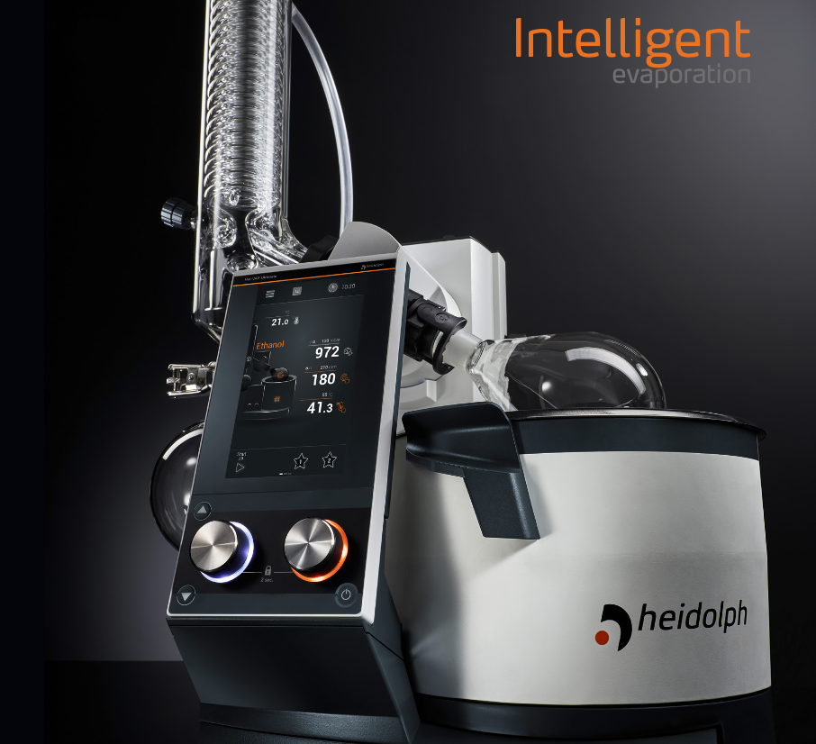
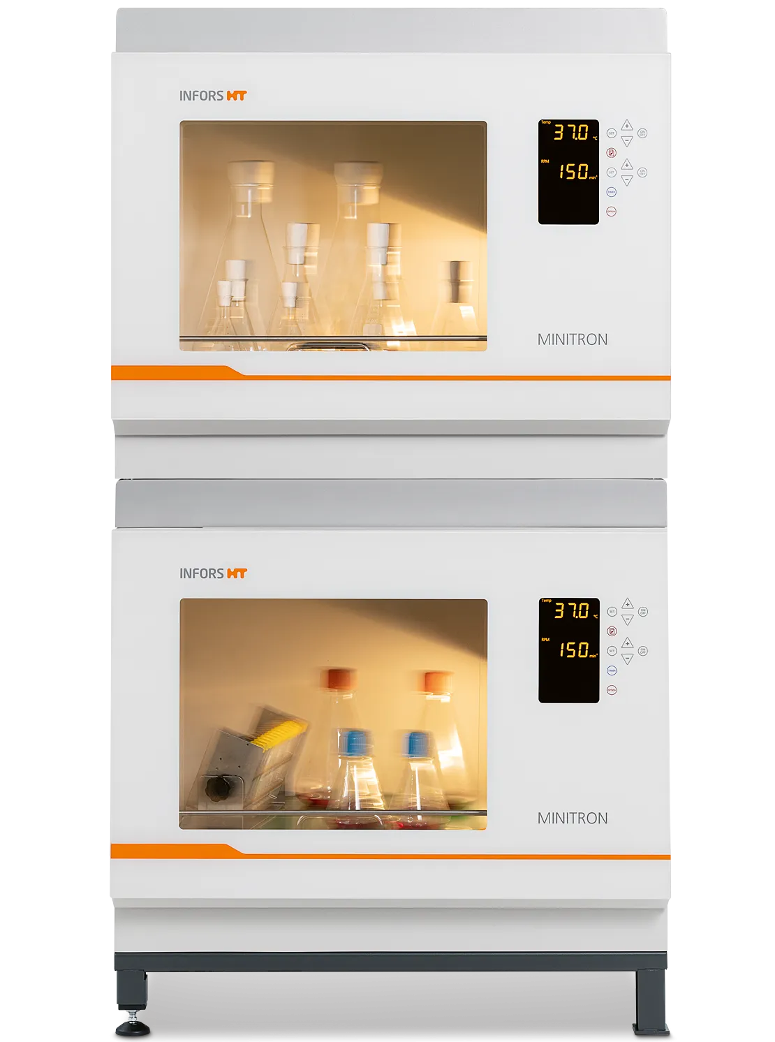
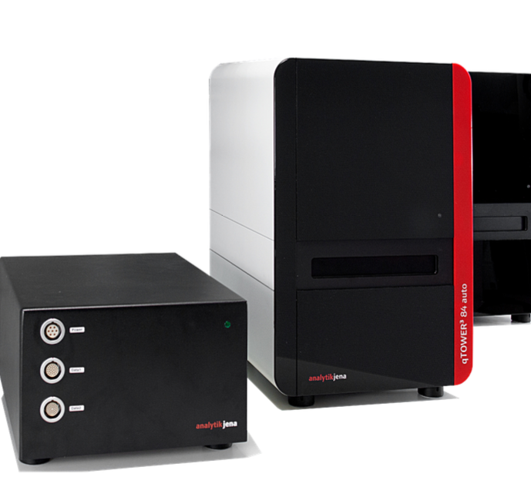
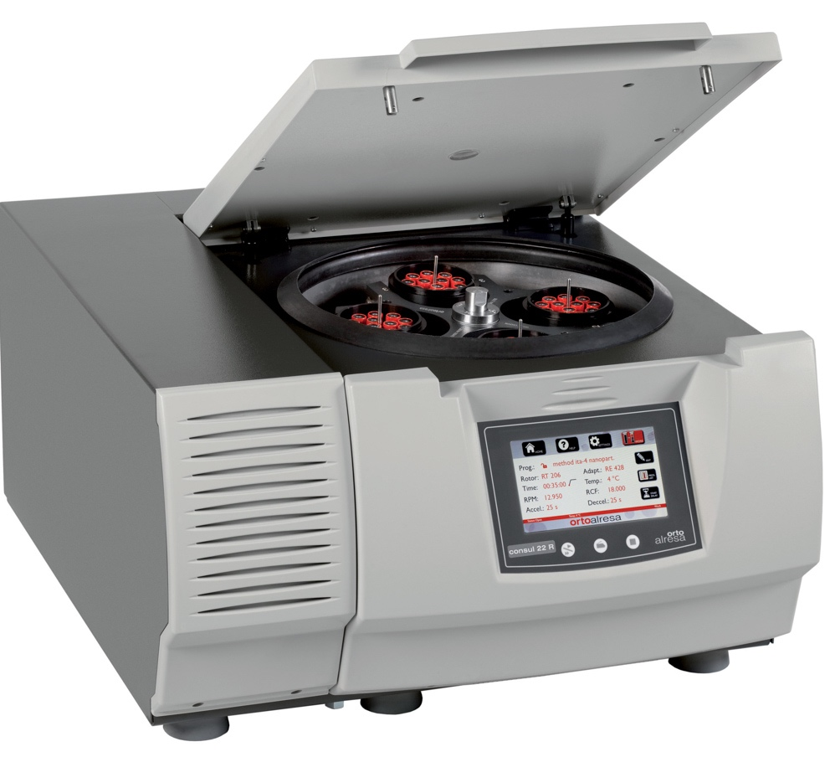
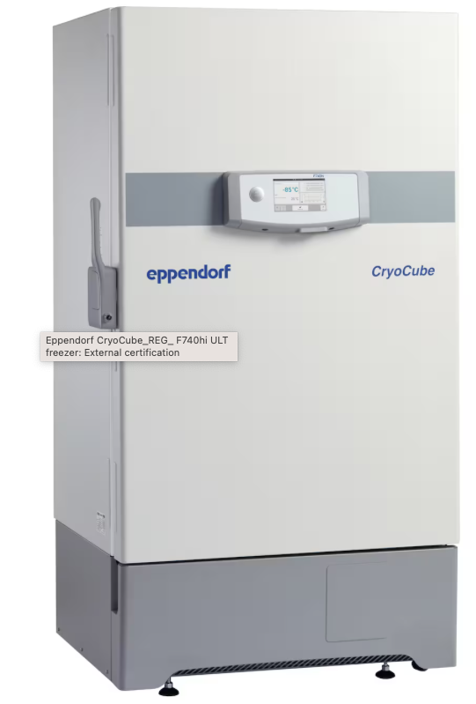
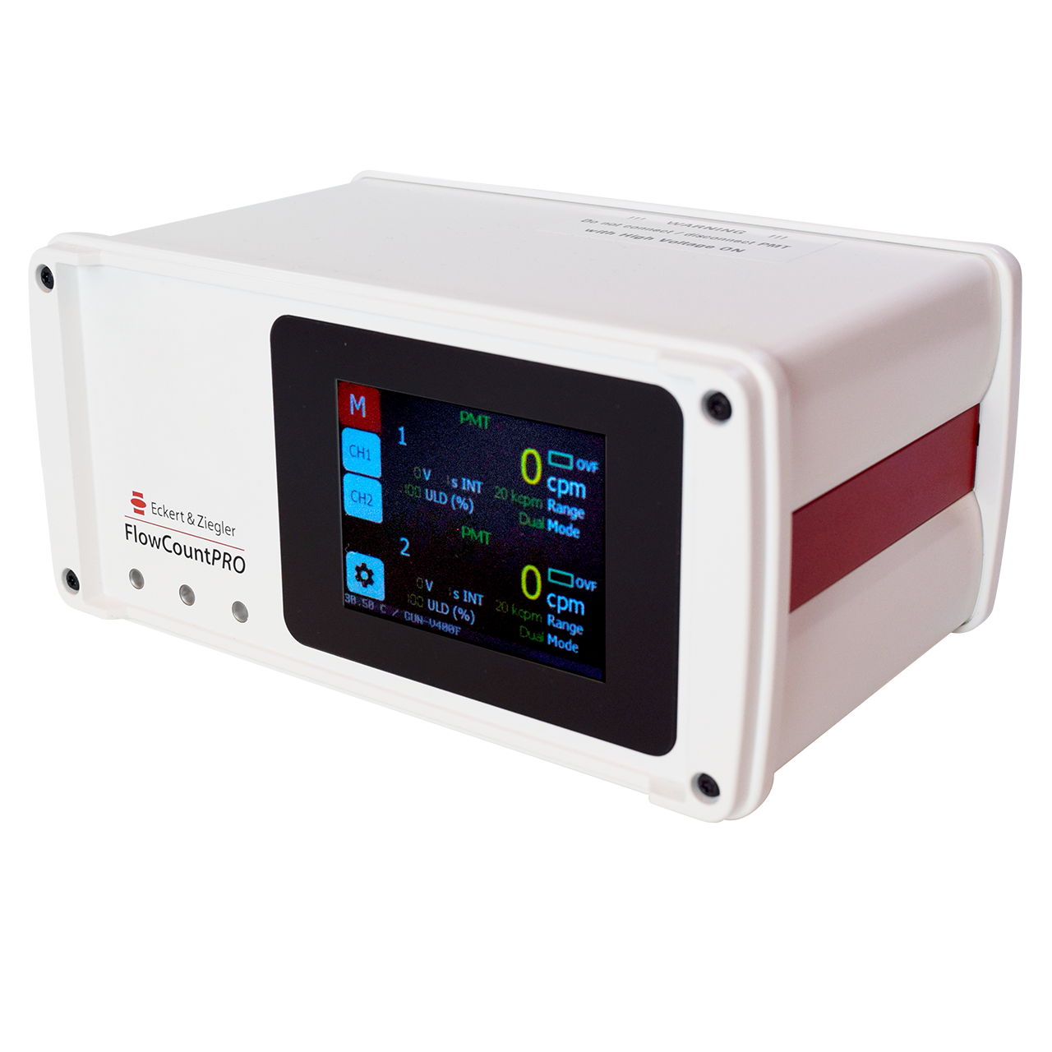
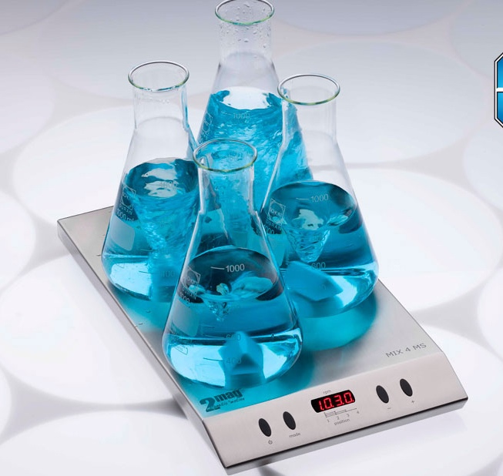
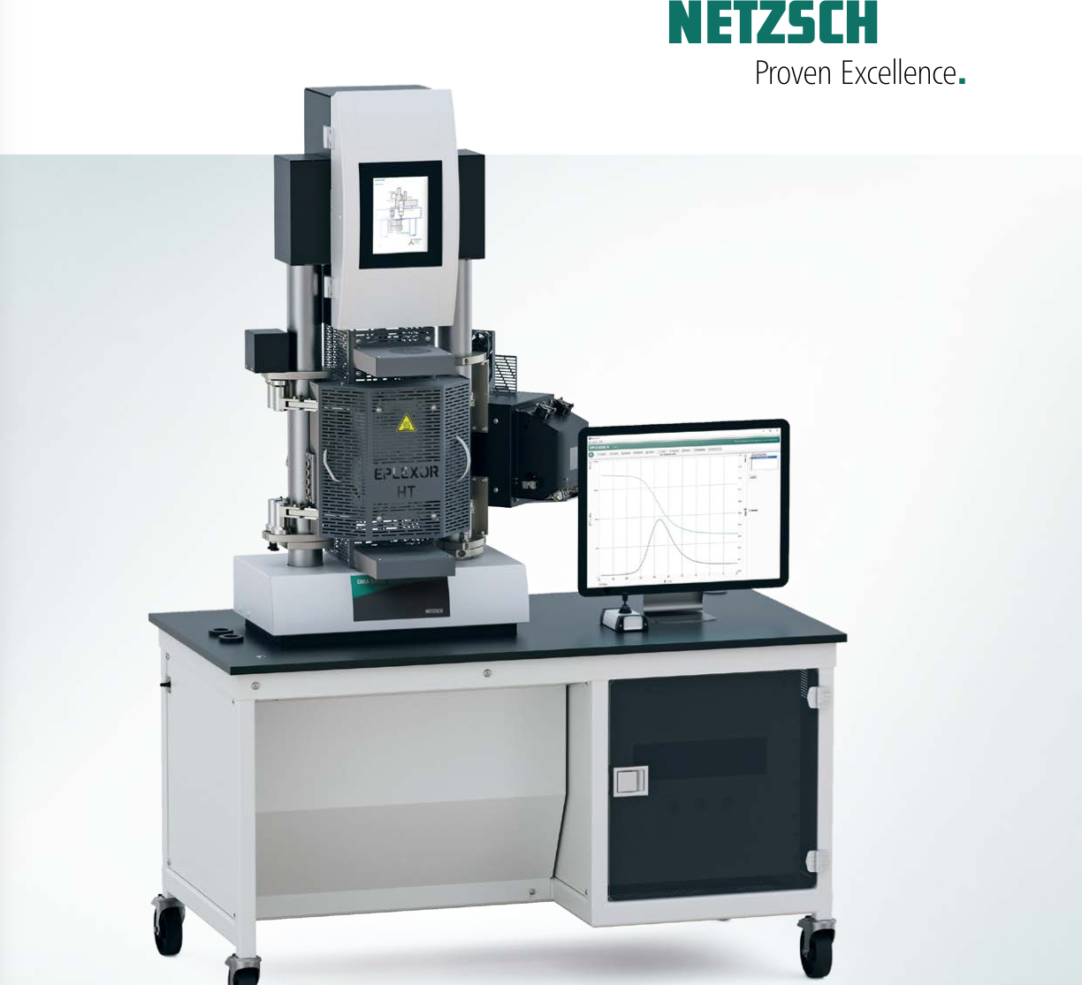
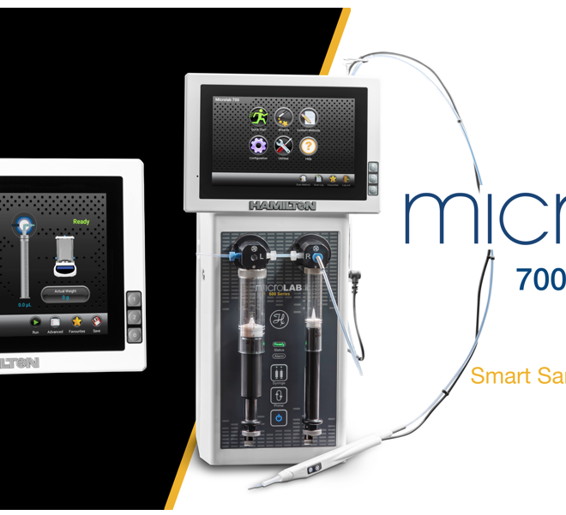
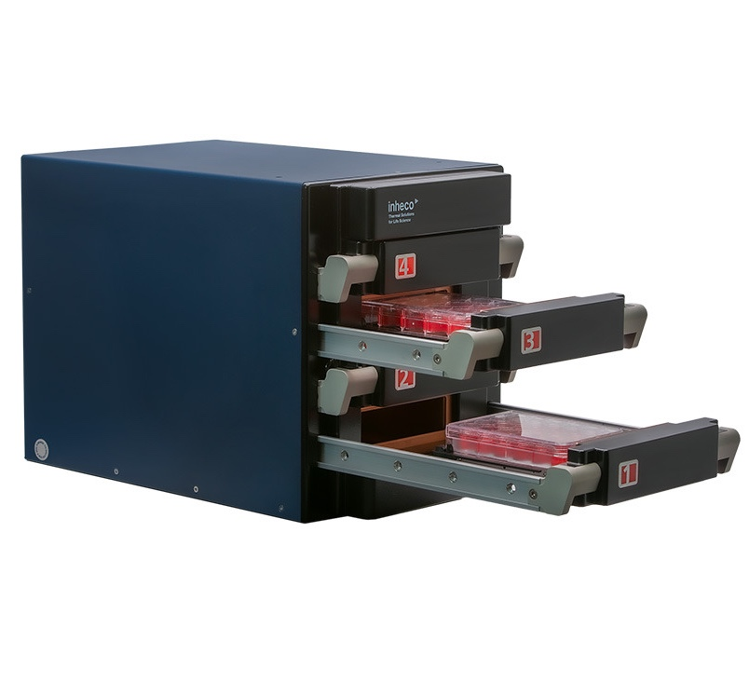
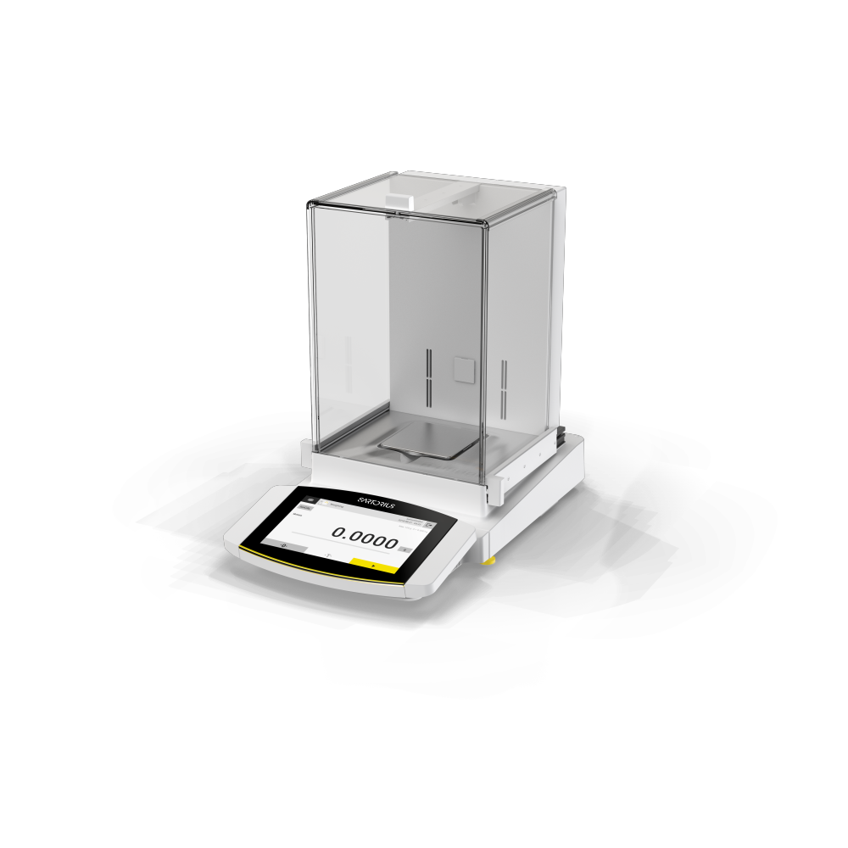
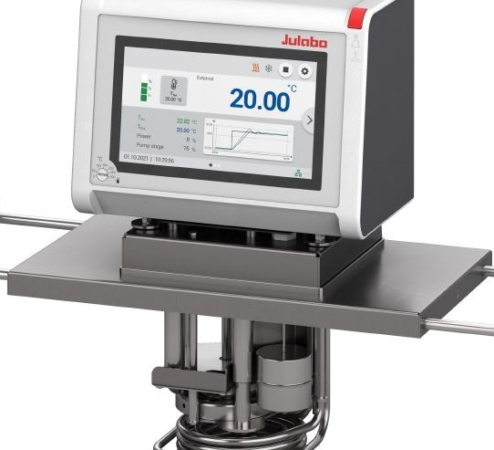
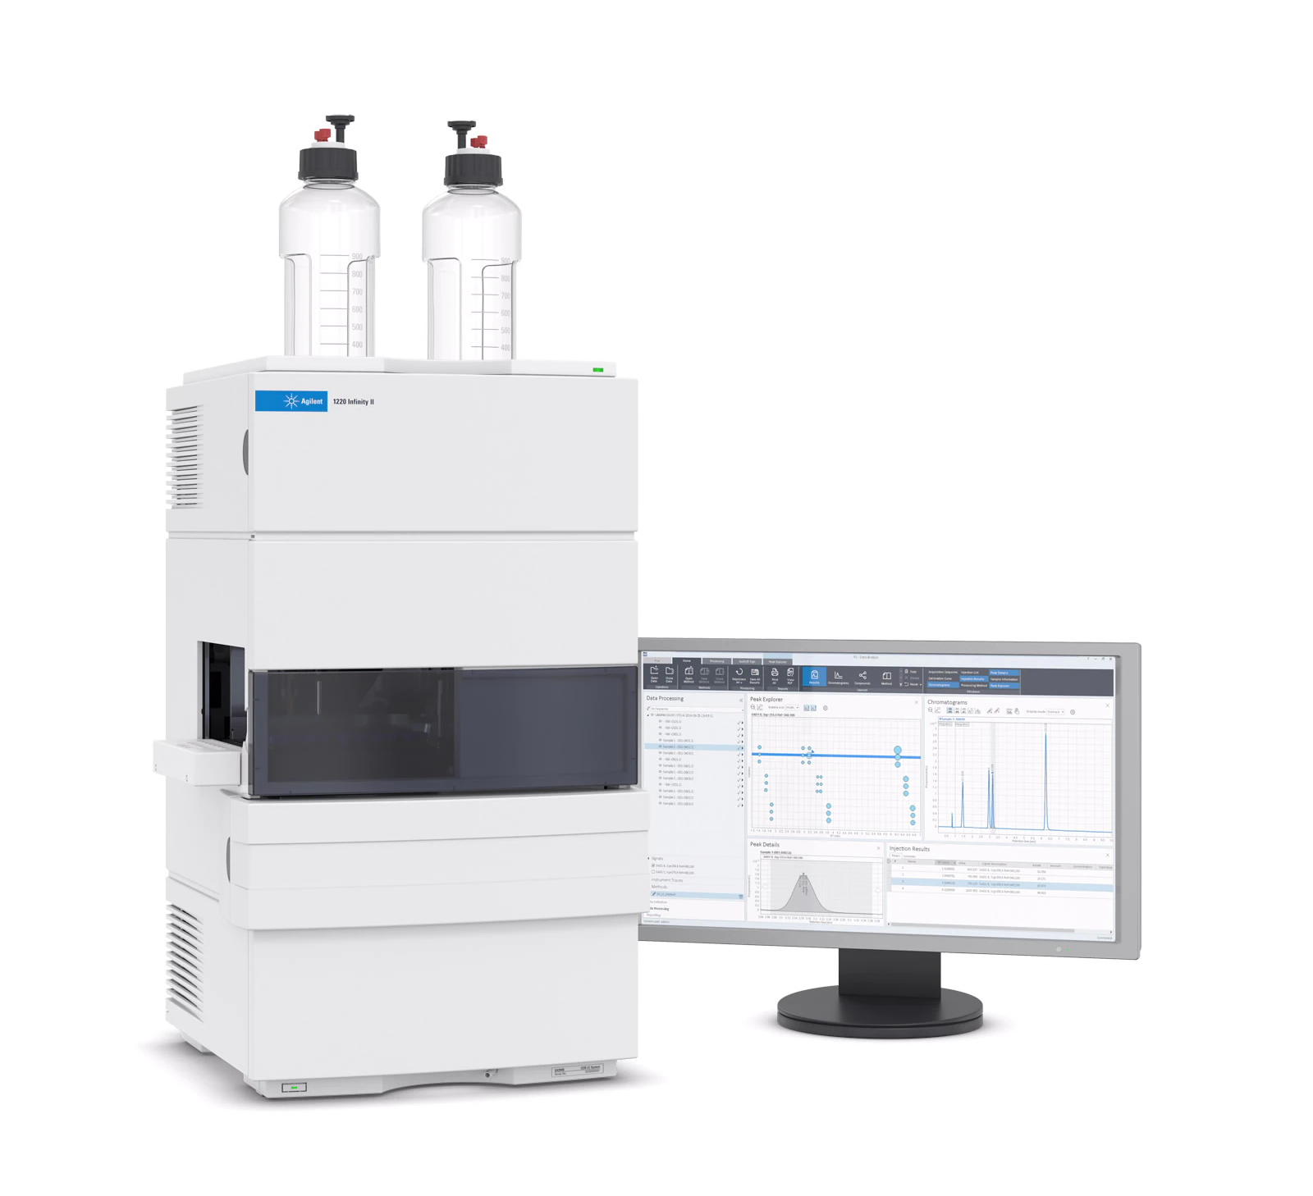
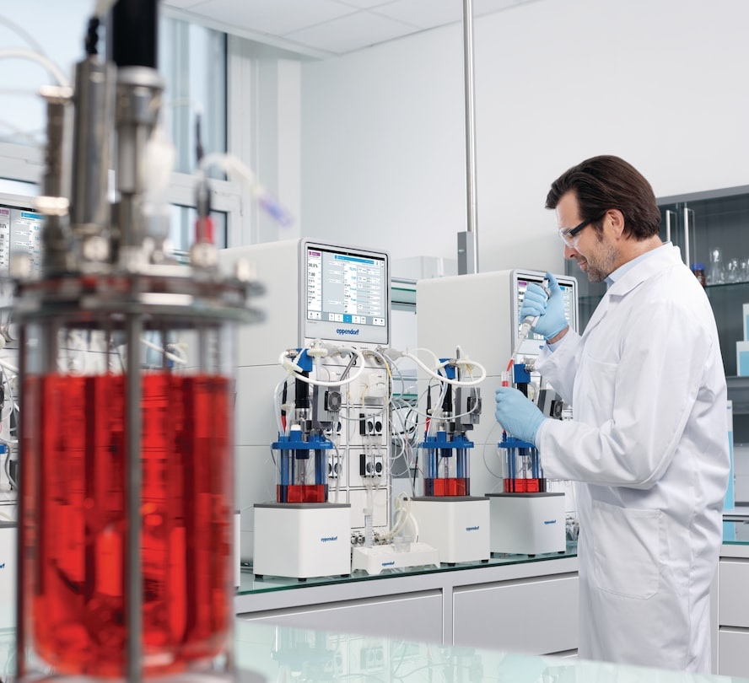



LADS - Let's make Plug & Play Interoperability a Reality!
All images trademarks, logos and brand names are the property of their respective owners.
Notes:
You might remember the various laboratory instruments with LADS information models that I presented a few minutes ago.
LADS OPC UA allows for standardized integration of these instruments into automation applications, leading to several benefits, including:
Better reproducibility of processes
Improved data integrity
Increased efficiencies
Automation of tedious operations, and more.
Last but not least, increased automation frees up valuable human resources, enabling them to focus on higher-value tasks.
However, upon closer examination, we realize that most equipment was not originally designed for automation integration but for manual operation by human operators.
This presents us with a challenging situation that requires:
Automation of workflows with instruments not initially designed for automation.
Maintaining high flexibility due to frequent changes in laboratory workflows.
Ensuring close collaboration with human operators.
To meet these demands, the integration of collaborative and mobile robots into laboratory workflows becomes essential.
By combining automation with human expertise, we can achieve efficient and effective laboratory operations.

Slide 23









OPC UA – The Industrial Interoperability Standard
Building Automation & Control
Robotics & Indoor Positioning
Laboratory & Analytical Devices
Asset Mgt …
From Laboratory to
Cloud
Interoperable with FAIR data
Domain-Specific Semantics & Pragmatics
Cross-Domain Semantics & Syntax, ..

Slide 24



Thank You!
https://opcfoundation.org/markets-collaboration/lads/
https://www.spectaris.de/en/association/thespectarisindustries/networked-laboratory-equipment/
https://www.linkedin.com/company/LADS-OPC-UA/
https://www.linkedin.com/Dr-Matthias-Arnold/
https://opcfoundation-events.com/2023/05/12/opc-day-international-2023/#arnold Allotrope Connect Keynote: https://www.youtube.com/watch?v=l7jXcO0QH7Y
M.Arnold@AixEngineers.de
Notes:
Thank you very much for your interest in LADS OPC UA ,
The Laboratory and Analytical Device Standard
I’m happy to receive your feedback, discuss your comments and answer your questions.

